Slide 2
Spike Frequency Adaptation
Model Sensory Adaptation in Neuromorphic Hardware
  Model Sensory Adaptation using adaptive integrate and fire neurons
    Model the circuit
      Model the submechanism of the circuit
        Model STD
        Model STF
        Model SFA in a manner that let's us build a sensory adaptation network
          Model SFA in a manner that is biologically similar to the neurons we think are present in the cortical circuit
            PC
            SST
            PV
            GN

Slide 3

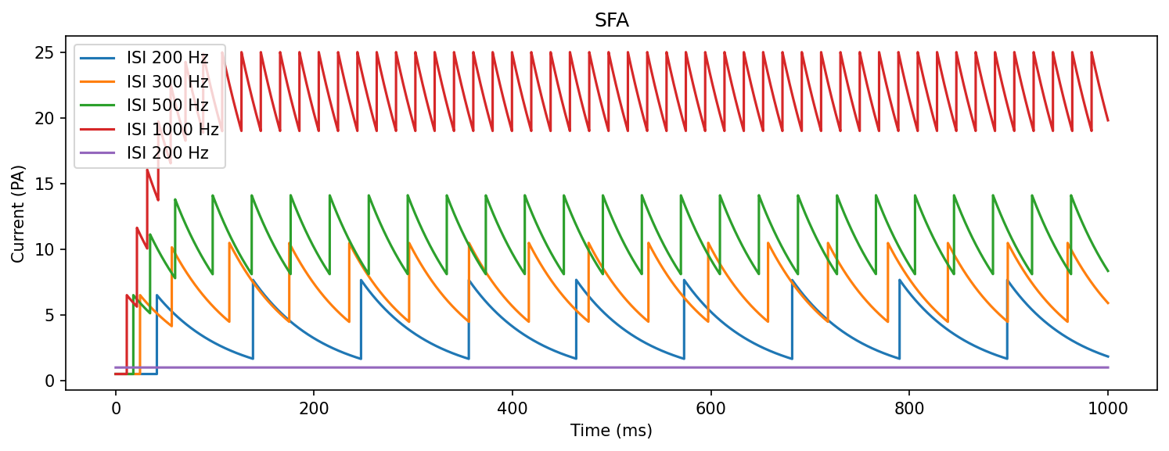

Slide 4
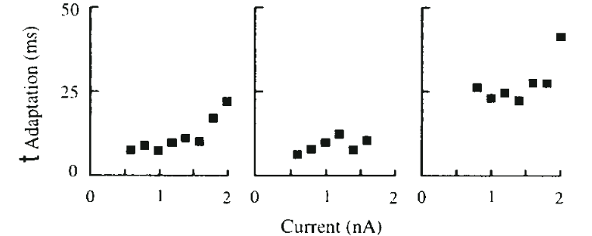
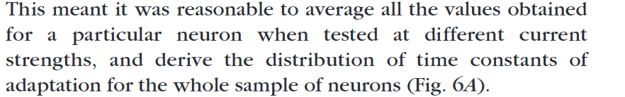

Slide 5
SFA Metrics
F_adap and T_adap correleate significantly with cortical depth
Layer | 2 to 4 | 5 to 6
T_adap | 3-24 ms | 50 ms
F_adap | 55-80% | 35-65%

Slide 6
